Slide 1
Extended Memory Controller and the MPAX registers And Cache
Multicore programming and Applications
February 19, 2013

Slide 2
Agenda
A little reminder of the 6678
Purpose of MPAX part of XMC
CorePac MPAX registers
CorePac MAR registers
Teranet Access MPAX registers
Real code examples
EDMA and cache usage

Slide 3
KeyStone and C66 CorePac
Memory Subsystem
Application-Specific
1 to 8 C66x CorePac DSP Cores operating at up to 1.25 GHz
Fixed- and floating-point operations
Code compatible with other C64x+ and C67x+ devices
L1 Memory
Can be partitioned as cache and/or RAM
32KB L1P per core
32KB L1D per core
Error detection for L1P
Memory protection
Dedicated L2 Memory
Can be partitioned as cache and/or RAM
512 KB to 1 MB Local L2 per core
Error detection and correction for all L2 memory
Direct connection to memory subsystem
Coprocessors
C66x™
CorePac
L1P
L1D
Cache/RAM
Cache/RAM
L2 Memory Cache/RAM
Miscellaneous
1 to 8 Cores @ up to 1.25 GHz
HyperLink
TeraNet
Multicore Navigator
External Interfaces
Network Coprocessor
Notes:
3
NEW

Slide 4
KeyStone I Memory Subsystem
Memory Subsystem
Application-Specific
Multicore Shared Memory (MSM SRAM)
1 to 4 MB
Available to all cores
Can contain program and data
All devices except C6654
Multicore Shared Memory Controller (MSMC)
Arbitrates access of CorePac and SoC masters to shared memory
Provides a connection to the DDR3 EMIF
Provides CorePac access to coprocessors and IO peripherals
Provides error detection and correction for all shared memory
Memory protection and address extension to 64 GB (36 bits)
Provides multi-stream pre-fetching capability
DDR3 External Memory Interface (EMIF)
Support for 16-bit, 32-bit, and (for C667x devices) 64-bit modes
Specified at up to 1600 MT/s
Supports power down of unused pins when using 16-bit or 32-bit width
Support for 8 GB memory address
Error detection and correction
MSM
Coprocessors
DDR3 EMIF
SRAM
MSMC
C66x™
CorePac
L1P
L1D
Cache/RAM
Cache/RAM
L2 Memory Cache/RAM
Miscellaneous
1 to 8 Cores @ up to 1.25 GHz
HyperLink
TeraNet
Multicore Navigator
External Interfaces
Network Coprocessor
Notes:
4
NEW

Slide 5
TeraNet Switch Fabric
Memory Subsystem
Application-Specific
A non-blocking switch fabric that enables fast and contention-free internal data movement
Provides a configured way – within hardware – to manage traffic queues and ensure priority jobs are getting accomplished while minimizing the involvement of the CorePac cores
Facilitates high-bandwidth communications between CorePac cores, subsystems, peripherals, and memory
MSM
Coprocessors
DDR3 EMIF
SRAM
MSMC
C66x™
CorePac
L1P
L1D
Cache/RAM
Cache/RAM
L2 Memory Cache/RAM
Miscellaneous
1 to 8 Cores @ up to 1.25 GHz
HyperLink
TeraNet
Multicore Navigator
Queue
Packet
Manager
DMA
x2
x4
t
T
e
h
C
R
I
n
c
Security
e
P
O
r
t
h
Device Specific I/O
A
Device Specific I/O
e
i
c
GPIO
2
I
S
I
C
U
I
h
w
t
Accelerator
P
R
t
S
i
S
E
w
S
Packet
I
Accelerator
I
M
x2
G
S
Network Coprocessor
Notes:
5
NEW

Slide 6
KeyStone I TeraNet Data Connections
HyperLink
S
MSMC
DDR3
S
M
CPUCLK/2
256bit TeraNet
Shared L2
S
HyperLink
DDR3
M
S
S
S
S
M
TPCC
16ch QDMA
TC0
M
EDMA_0
TC1
M
Facilitates high-bandwidth communication links between DSP cores, subsystems, peripherals, and memories.
Supports parallel orthogonal communication links
XMC
S
L2 0-3
M
SRIO
S
Core
M
M
S
Core
M
M
S
Core
M
Network
Coprocessor
M
SRIO
TPCC
64ch
QDMA
TC2
M
S
TC3
M
S
TPCC
64ch
QDMA
TC6
M
TCP3e_W/R
TC4
M
TC5
TC7
M
M
TC8
M
TC9
M
S
EDMA_1,2
TCP3d
S
CPUCLK/3
128bit TeraNet
TCP3d
TAC_BE
TAC_FE
S
M
RAC_FE
RAC_BE0,1
S
M
RAC_FE
RAC_BE0,1
S
M
FFTC / PktDMA
M
FFTC / PktDMA
M
VCP2 (x4)
S
VCP2 (x4)
S
VCP2 (x4)
AIF / PktDMA
S
M
VCP2 (x4)
S
QMSS
M
QMSS
PCIe
S
M
S
PCIe
DebugSS
M
Notes:
CPT see physical addresses. In MSMC, one CPT per bank.

Slide 7
Memory Translation
All address buses inside CorePac and the Teranet are 32 bit wide
Devices support up to 8GB external memory, requires at least 33 bits (in addition to 2GB of internal memory space)
The solution – translation from logical (32 bit) to physical (36 bit) address. This is done by the Memory Protection and extension/translation unit

Slide 8
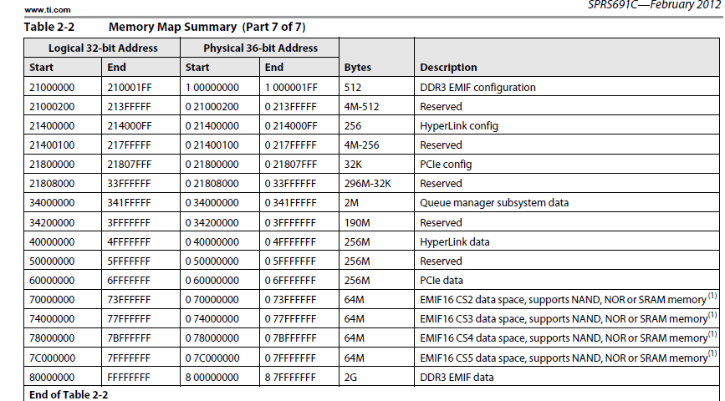
A page from the 6678 memory map Translation memory

Slide 9
MPAX Registers in keyStone devices CorePac
Each C66x Core has a set of 16 MPAX 64-bit registers that are used for direct access to the MSMC
Each 64-bit register translates a logical segment into physical segment, from 32 bits to 36 bits
In addition, the MPAX registers control the access permissions for the memory segment

Slide 10
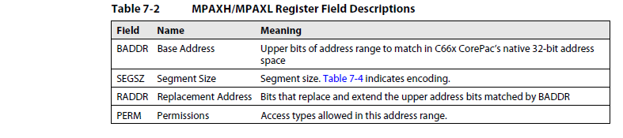
Structure of the MPAX registers (from the CorePac User Guide)
Segment size can be between 4KB to 4GB (power of 2)
Permissions are for user mode (read, write, execute) and for supervisor mode (read, write, execute)
(Mode is assigned by the operating system, default is supervisor)

Slide 11
The MPAX Address configuration
Each register translates logical memory into physical memory for the segment.
Logical base address (up to 20 bits) is the upper bits of the logical segment base address. The lower N bits are zero where N is determined by the segment size:
For segment size 4K, N = 12 and the base address uses 20 bits.
For segment size 8k, N=13 and the base address uses only 19 bits.
For segment size 1G, N=30 and the base address uses only 2 bits.
Physical (replacement address) base address (up to 24 bits) is the upper bits of the physical (replacement) segment base address. The lower N bits are zero where N is determined by the segment size:
For segment size 4K, N = 12 and the base address uses up to 24 bits.
For segment size 8k, N=13 and the base address uses up to 23 bits.
For segment size 1G, N=30 and the base address uses up to 6 bits.

Slide 12
MPAX: Typical Use Cases
Speeds up processing by making shared L2 MSMC cached by private L2 (L3 shared).
Uses the same logical address in all cores; Each one points to a different physical memory.
Uses part of shared L2 to communicate between cores. So makes part of shared L2 non-cacheable, but leaves the rest of shared L2 cacheable.
Utilizes 8G of external memory; 2G for each core with some over-lapping.

Slide 13
CorePac MPAX Reset Values
The XMC configures MPAX segments 0 and 1 so that C66x CorePac can access system memory
Segment 0 power up configure it to address all internal memories (up to address 0x7fff ffff) to the same memory
The power up configuration is that segment 1 remaps 8000_0000 – FFFF_FFFF in C66x CorePac’s address space to 8:0000_0000 – 8:7FFF_FFFF in the system address map
This corresponds to the first 2GB of address space dedicated to EMIF by the MSMC controller

Slide 14
The MPAX Registers
System
Physical 36-bit Memory Map
MPAX (Memory Protection and Extension) Registers:
Translate between physical and logical address
16 registers (64 bits each) control (up to) 16 memory segments.
Each register translates logical memory into physical memory for the segment.
F:FFFF_FFFF
8:8000_0000
8:7FFF_FFFF
8:0000_0000
7:FFFF_FFFF
C66x CorePac
Logical 32-bit Memory Map
MPAX Registers
1:0000_0000
0:FFFF_FFFF
FFFF_FFFF
8000_0000
7FFF_FFFF
0:8000_0000
0:7FFF_FFFF
0:0C00_0000
0:0BFF_FFFF
0C00_0000
0BFF_FFFF
Segment 1
Segment 0
0000_0000
0:0000_0000

Slide 15
The protection Part
What happen if the application tries to access logical memory that the MPAX register does not have?
A fault event will be generated – Software decide what to do

Slide 16
The MAR Registers
MAR (Memory Attributes) Registers:
256 registers (32 bits each) control 256 memory segments:
Each segment size is 16MBytes, from logical address 0x0000 0000 to address 0xFFFF FFFF.
The first 16 registers are read only. They control the internal memory of the core.
Each register controls the cacheability of the segment (bit 0) and the prefetchability (bit 3). All other bits are reserved and set to 0.

Slide 17
Teranet and CorePac Access MSMC
CorePac
0
CorePac
1
CorePac
2
CorePac
3
XMC
XMC
XMC
XMC
MPAX
MPAX
MPAX
MPAX
256
256
256
256
CorePac
CorePac
CorePac
CorePac
Slave Port
Slave Port
Slave Port
Slave Port
System
Slave Port
for Shared SRAM
(SMS)
Memory
Protection &
Extension
Unit
(MPAX)
MSMC Datapath
Arbitration
TeraNet
256
256
Shared RAM
2048 KB
System Slave Port for External Memory
(SES)
Memory
Protection &
Extension
Unit
(MPAX)
Error Detection & Correction (EDC)
256
256
256
MSMC Core
MSMC System
MSMC EMIF
Master Port
Master Port
Events
256
256
TeraNet
To SCR_2_B
and the DDR

Slide 18
A note about Privilege ID in keyStone devices
Each C66x Core is assigned a unique privilege ID (PrivID) value
Data I/O masters are assigned one PrivID, with the exception of the EDMA, which inherits the PrivID value of the master that configures it for each transfer.
There are 16 total PrivID values supported in KeyStone devices.

Slide 19
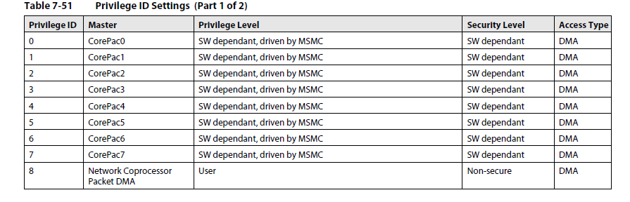
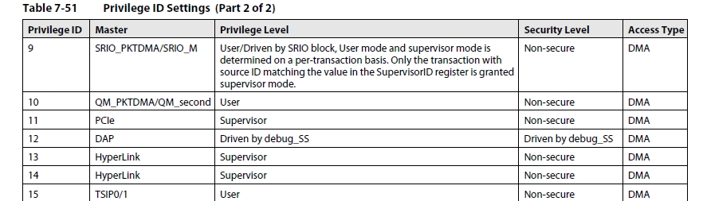
Privilege ID Settings

Slide 20
Access the MSMC from the Teranet (MSMC slave ports)
SES (slave port External Memory) access addresses 0x8000 0000 to address 0xffff ffff
SMS (slave port Shared SRAM) access addresses 0x0c000 0000 to 0x7fff ffff
For access via the TeraNet, there are 16 sets of MPAX registers for System Slave Memory port and 16 sets of MPAX register for System Slave External port. Each set has 8 registers (8 for SES set and 8 for SMS set)
Each one set of the 16 sets corresponds to a different Privilege ID .

Slide 21
SES and SMS PMAX Reset Values
At reset, the MPAX segment 0 register pair has initial values that set up unrestricted access to the full MSMC SRAM address space and 2 GB of the EMIF address space.
All other segments come up with the permission bits and size set to 0
For each PrivID, SMS_MPAXH[0] is reset to 0x0C000017 and SMS_MPAXL[0] is reset to 0x00C000BF, (i.e., segment 0 is sized to 16 MB and matches any accesses to the address range 0x0CXXXXXX).
For each PrivID, SES_MPAXH[0] is reset to 0x8000001E and SES_MPAXL[0] is reset to 0x800000BF, (i.e., the segment 0 is sized to 2 GB and matches any accesses to the address range 0x8XXXXXXX). This 2 GB space starts at the external memory base address of 0x80000000.
SMS_MPAXH and SMS_MPAXL for segments 1 through 7 come out of reset as 0x0C000000 and 0x00C00000 respectively. SES_MPAXH and SES_MPAXL for segments 1 through 7 come out of reset as all zeros.

Slide 22
Configure the MPAX registers – actual code
System
Physical 36-bit Memory Map
// Map 1 MB from 0x8810_0000 to 0x0_0C00_0000 (XMC)
// Use segment 3 – can use any segment
lvMpaxh.segSize = 0x13; // 1 MB see table 7-4
lvMpaxh.bAddr = 0x88100; // 32-bit address >> 12
CSL_XMC_setXMPAXH(3,&lvMpaxh);
lvMpaxl.ux = 1;
lvMpaxl.uw = 1;
lvMpaxl.ur = 1;
lvMpaxl.sx = 1;
lvMpaxl.sw = 1;
lvMpaxl.sr = 1;
lvMpaxl.rAddr = 0x00C000; // 36-bit address >> 12
CSL_XMC_setXMPAXL(3,&lvMpaxl);
F:FFFF_FFFF
8:8000_0000
8:7FFF_FFFF
8:0000_0000
7:FFFF_FFFF
C66x CorePac
Logical 32-bit Memory Map
FFFF_FFFF
MPAX Registers
1:0000_0000
0:FFFF_FFFF
881F_FFFF
8810_0000
0:8000_0000
0:7FFF_FFFF
0:0C10_0000
0:0C00_0000
0:0BFF_FFFF
0C00_0000
0BFF_FFFF
Segment 1
Segment 0
0000_0000
0:0000_0000

Slide 23
Configure the MPAX registers – actual code
// Map 4 KB from 0x2100_0000 to 0x1_0000_0000 (XMC)
// Use segment 2 or any other segment
lvMpaxh.segSize = 0xB; // 4 KB – see table 7-4 of CorePac
lvMpaxh.bAddr = 0x21000; // 32-bit address >> 12
CSL_XMC_setXMPAXH(2,&lvMpaxh);
lvMpaxl.ux = 1;
lvMpaxl.uw = 1;
lvMpaxl.ur = 1;
lvMpaxl.sx = 1;
lvMpaxl.sw = 1;
lvMpaxl.sr = 1;
lvMpaxl.rAddr = 0x100000; // 36-bit address >> 12
CSL_XMC_setXMPAXL(2,&lvMpaxl);

Slide 24
Configure MPAX registers for 1GB for each core
// Map 1 GB from 0x8000_0000 to 8 different addresses in the external memory
// The purpose is to give each core different physical address but have the same logical address
lvSesMpaxh.segSz = 0x1D; // 1GB
lvSesMpaxh.baddr = 0x2; // 0x8000 0000 32-bit address >> 30
CSL_MSMC_setSESMPAXH(10,2,&lvSesMpaxh);
// For each core chose a different setting, start at core 0
lvSesMpaxl.raddr = 0x20; // 8 0000 0000 36-bit >> 30 core 0
lvSesMpaxl.raddr = 0x21; // 8 4000 0000 36-bit >> 30 core 1
lvSesMpaxl.raddr = 0x22; // 8 8000 0000 36-bit >> 30 core 2
lvSesMpaxl.raddr = 0x23; // 8 C000 0000 36-bit >> 30 core 3
…
lvSesMpaxl.raddr = 0x27; // 9 C000 0000 36-bit >> 30 core 7
CSL_MSMC_setSESMPAXL(10,2,&lvSesMpaxl);

Slide 25
Configure the SES MPAX registers for Non cached 1M of MSMC shared memory– actual code
// Map 1 MB from 0x8800_0000 to 0x0_0C10_0000 (MSMC)
// The purpose is to reach MSMC that is not cacheable or pre-fetch
//See MAR registers later
lvSesMpaxh.segSz = 0x13;
lvSesMpaxh.baddr = 0x88100; // 32-bit address >> 12
CSL_MSMC_setSESMPAXH(10,2,&lvSesMpaxh);
lvSesMpaxl.ux = 1;
lvSesMpaxl.uw = 1;
lvSesMpaxl.ur = 1;
lvSesMpaxl.sx = 1;
lvSesMpaxl.sw = 1;
lvSesMpaxl.sr = 1;
lvSesMpaxl.raddr = 0x00C000; // 36-bit address >> 12
CSL_MSMC_setSESMPAXL(10,2,&lvSesMpaxl);

Slide 26
Configure the MAR registers – actual code
lvMarPtr = (volatile uint32_t*)0x018480030; // MAR12 (0x0C00_0000:0x0CFF_FFFF)
// Set MAR attributes for MAR12
lvMar = 1;
#ifdef MY_ENABLE_PREFETCH
lvMar = lvMar | 8;
#endif
*lvMarPtr = lvMar;

Slide 27
Configure the MAR registers – actual code
// Set MAR attributes for MAR136:MAR143 (0x8800_0000:0x8FFF_FFFF)
//This is the region that
for (i=0; i<8; i++)
{
lvMar = 0;
*lvMarPtr = lvMar;
lvMarPtr++;
//CACHE_disableCaching(136+i);
}

Slide 28
Internal Buses
Program Address x32
PC
L1
Memories
Program Data x256
Fetch
Data Address - T1 x32
A
Regs
Data Data - T1 x64
L2 and
External
Memory
Data Address - T2 x32
B
Regs
Data Data - T2 x64
Peripherals

Slide 29
Cache Sizes and More
Cache | Maximum Size | Line Size | Ways | Coherency | Memory Banks
L1P | 32K bytes | 32 bytes | One | No hardware coherency | NA
L1D | 32K bytes | 64 bytes | Two | Coherent with L2 | 8 x 32-bit
L2 | 512K bytes | 128 bytes | Four | User must maintain coherency with external world: invalidate write-back write-back invalidate | 2 x 128-bit

Slide 30
Memory Read Performance
 |  |  |  |  | CPU stalls
 |  |  |  |  | Single Read |  | Burst Read
 | Source | L1 cache | L2 cache | Prefetch | No victim | Victim | No victim | Victim
 | ALL | Hit | NA | NA | 0 | NA | 0 | NA
 | Local L2 RAM | Miss | NA | NA | 7 | 7 | 3.5 | 10
 | MSMC RAM (SL2) | Miss | NA | Hit | 7.5 | 7.5 | 7.4 | 11
 | MSMC RAM (SL2) | Miss | NA | Miss | 19.8 | 20.1 | 9.5 | 11.6
 | MSMC RAM (SL3) | Miss | Hit | NA | 9 | 9 | 4.5 | 4.5
 | MSMC RAM (SL3) | Miss | Miss | Hit | 10.6 | 15.6 | 9.7 | 129.6
 | MSMC RAM (SL3) | Miss | Miss | Miss | 22 | 28.1 | 11 | 129.7
 | DDR RAM (SL2) | Miss | NA | Hit | 9 | 9 | 23.2 | 59.8
 | DDR RAM (SL2) | Miss | NA | Miss | 84 | 113.6 | 41.5 | 113
 | DDR RAM (SL3) | Miss | Hit | NA | 9 | 9 | 4.5 | 4.5
 | DDR RAM (SL3) | Miss | Miss | Hit | 12.3 | 59.8 | 30.7 | 287
 | DDR RAM (SL3) | Miss | Miss | Miss | 89 | 123.8 | 43.2 | 183
SL2 – Configured as Shared Level 2 Memory (L1 cache enabled, L2 cache disabled)
SL3 – Configured as Shared Level 3 Memory (Both L1 cache and L2 cache enabled)

Slide 31
Memory Read Performance - Summary
Prefetching reduces the latency gap between local memory and shared (internal/external) memories.
Prefetching in XMC helps reducing stall cycles for read accesses to MSMC and DDR.
Improved pipeline between DMC/PMC and UMC significantly reduces stall cycles for L1D/L1P cache misses.
Performance hit when both L1 and L2 caches contain victims
Shared memory (MSMC or DDR) configured as Level 3 (SL3) have a potential “double victim” performance impact
When victims are in the cache, burst reads are slower than single reads
Reads have to wait for victim writes to complete
MSMC configured as Level 3 (SL3) is slower than Level 2 (SL2)
There is a “double victim” impact
DDR configured as Level 3 (SL3) is slower than Level 2 (SL2) in case of L2 cache misses
There is a “double victim” impact
If DDR does not have large cacheable data, it can be configured as Level 2 (SL2).

Slide 32
Memory Write Performance
 |  |  |  |  | CPU stalls
 |  |  |  |  | Single Write |  | Burst Write
 | Source | L1 cache | L2 cache | Prefetch | No victim | Victim | No victim | Victim
 | ALL | Hit | NA | NA | 0 | NA | 0 | NA
 | Local L2 RAM | Miss | NA | NA | 0 | 0 | 1 | 1
 | MSMC RAM (SL2) | Miss | NA | Hit | 0 | 0 | 2 | 2
 | MSMC RAM (SL2) | Miss | NA | Miss | 0 | 0 | 2 | 2
 | MSMC RAM (SL3) | Miss | Hit | NA | 0 | 0 | 3 | 3
 | MSMC RAM (SL3) | Miss | Miss | Hit | 0 | 0 | 6.7 | 14.6
 | MSMC RAM (SL3) | Miss | Miss | Miss | 0 | 0 | 6.7 | 16.7
 | DDR RAM (SL2) | Miss | NA | Hit | 0 | 0 | 4.7 | 4.7
 | DDR RAM (SL2) | Miss | NA | Miss | 0 | 0 | 5 | 5
 | DDR RAM (SL3) | Miss | Hit | NA | 0 | 0 | 3 | 3
 | DDR RAM (SL3) | Miss | Miss | Hit | 0 | 0 | 16 | 114.3
 | DDR RAM (SL3) | Miss | Miss | Miss | 0 | 0 | 18.2 | 115.5
SL2 – Configured as Shared Level 2 Memory (L1 cache enabled, L2 cache disabled)
SL3 – Configured as Shared Level 3 Memory (Both L1 cache and L2 cache enabled)

Slide 33
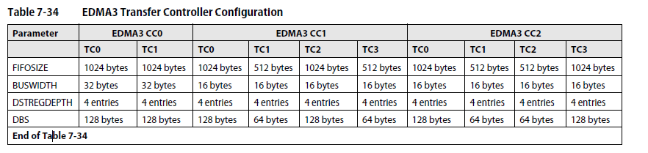
A word about the EDMA priorities in 6678
Choose the right edma controller (connectivity, location, clock, width)
In each channel controller, choose the right channel (lower channel number higher priorities) and transfer controller (The same)
The FIFO size determine the amount of overhead to choose the right TC
Consider parallel events and blocking

Slide 34
A Coherency Issue
Shared (DDR3/ Shared Local)
L1D
L2
CorePac2
RcvBuf
RcvBuf
RcvBuf
CPU
XmtBuf
XmtBuf
CorePac2
CorePac1
Another CorePac reads the buffer from shared memory.
The buffer resides in cache, not in external memory.
So the other CorePac reads whatever is in external memory; probably not what you wanted.
There are two solutions to data coherency ...

Slide 35
Solution 1: Flush & Clear the Cache
Shared (DDR3/SL)
L1D
L2
Core2
RcvBuf
RcvBuf
RcvBuf
CPU
XmtBuf
XmtBuf
writeback
Core2
CorePac1
When the CPU is finished with the data (and has written it to XmtBuf in L2), it can be sent to external memory with a cache writeback.
A writeback is a copy operation from cache to memory, writing back the modified (i.e. dirty) memory locations – all writebacks operate on full cache lines.
Use CSL CACHE_wbL1d to force a writeback.
No writeback is required if the buffer is never read (L1 cache is read allocate only).

Slide 36
Another Coherency Issue
Shared (DDR3/SL)
L1D
L2
CorePac2
RcvBuf
RcvBuf
RcvBuf
CPU
XmtBuf
XmtBuf
CorePac1
Another CorePac writes a new RcvBuf buffer to shared memory
When the current CorePac reads RcvBuf a cache hit occurs since the buffer (with old data) is still valid in cache
Thus, the current CorePac reads the old data instead of the new data

Slide 37
Another Coherency Solution (Using CSL)
Shared (DDR3/SL)
L1D
L2
CorePac2
RcvBuf
RcvBuf
RcvBuf
CPU
XmtBuf
XmtBuf
CorePac1
To get the new data, you must first invalidate the old data before trying to read the new data (clears cache line’s valid bits)
CSL provides an API to writeback with invalidate:
It writes back modified (i.e. dirty) data,
Then invalidates cache lines containing the buffer CACHE_wbInvL2((void *)RcvBuf, bytecount, CACHE_WAIT);

Slide 38
Solution 2: Keep Buffers in L2
Shared (DDR3/MSMC)
L1D
L2
EDMA
RcvBuf
RcvBuf
CPU
XmtBuf
EDMA
CorePac1
Configure some of L2 as RAM.
Use EDMA or PKTDMA to transfer buffers in this RAM space.
Coherency issues do not exist between L1D and L2.
Adding to Cache Coherency...

Slide 39
Prefetching Coherency Issue
Shared (DDR3/SL)
L1D
L2
read
Buf
preFetch
Buf
Buf
write
CPU
CorePac1
The Expanded Memory Controller (XMC) contains a pre-fetch buffer(s), controlled by a bit in MAR, used for data reading speed-up
This buffer is not used for writing data
A read/write/read sequence applied to the same buffer can cause the second read operation to read old data

Slide 40
Coherence Summary (1)
Internal (L1/L2) Cache Coherency is Maintained
Coherence between L1D and L2 is maintained by cache controller.
No CACHE operations needed for data stored in L1D or L2 RAM.
L2 coherence operations implicitly operate upon L1 as well.
Simple Rules for Error Free Cache
Before the DSP begins reading a shared external INPUT buffer, it should first BLOCK INVALIDATE the buffer.
After the DSP finishes writing to a shared external OUTPUT buffer, it should initiate an L2 BLOCK WRITEBACK.

Slide 41
Coherence Summary (2)
There is no hardware cache coherency maintenance between the following:
L1/L2 caches in CorePacs and MSMC memory
XMC prefetch buffers and MSMC memory
CorePac to CorePac via MSMC
EDMA/PKTDMA transfers between L1/L2 and MSMC are coherent.
Methods for maintaining coherency:
Write back after writing and cache invalidate before reading.
Use EDMA/PktDMA for L2→MSMC, MSMC→L2 or L2→L2 transfers.
Use MPAX registers to alias shared memory and use MAR register to disable shared memory caching for the aliased space.
Disable the MSMC prefetching feature.

Slide 42
Cache Alignment
False Addresses
Buffer
Cache Lines
Buffer
Buffer
False Addresses
Problem: How can I invalidate (or writeback) just the buffer?
In this case, you can’t
Definition: False Addresses are ‘neighbor’ data in the cache line, but outside the buffer range
Why Bad: Writing data to buffer marks the line ‘dirty’, which will cause entire line to be written to external memory, thus:
External neighbor memory could be overwritten with old data
Avoid “False Address” problems by aligning buffers to cache lines (and filling entire line):
Align memory to 128-byte boundaries*
Allocate memory in multiples of 128 bytes
* If only L1 cache is used, 64-byte alignment is sufficient
#define BUF 128
#pragma DATA_ALIGN (in, BUF)
short in[2][20*BUF];

Slide 43
Discussion and Questions

